Slide 1
Woodland Public Schools
Facilities and Safety Report
January 2021

Slide 2
FACILITIES REPORT
Completed 400 feet of gutter replacement on the north side of WMS.
Completed annual fire system inspections and backflow testing.
Transferred fire system monitoring to Johnson Controls Fire.
Completed main water line replacement in the green gym at WMS.
Installed 4 new bottle fill stations (WMS,CES, NFES).
Installed TEAM High portable building; occupancy expected 3rd week of February.
Completed annual boiler inspections and annual clean air agency report.
Completed carpet installs at NFES room 211 and WMS room 306.
Installed new 2HP garbage disposal in WMS kitchen.
Completed annual bleacher inspections.
Prepping all schools for the return of students (PPE, physical arrangement of furniture, etc.).

Slide 3
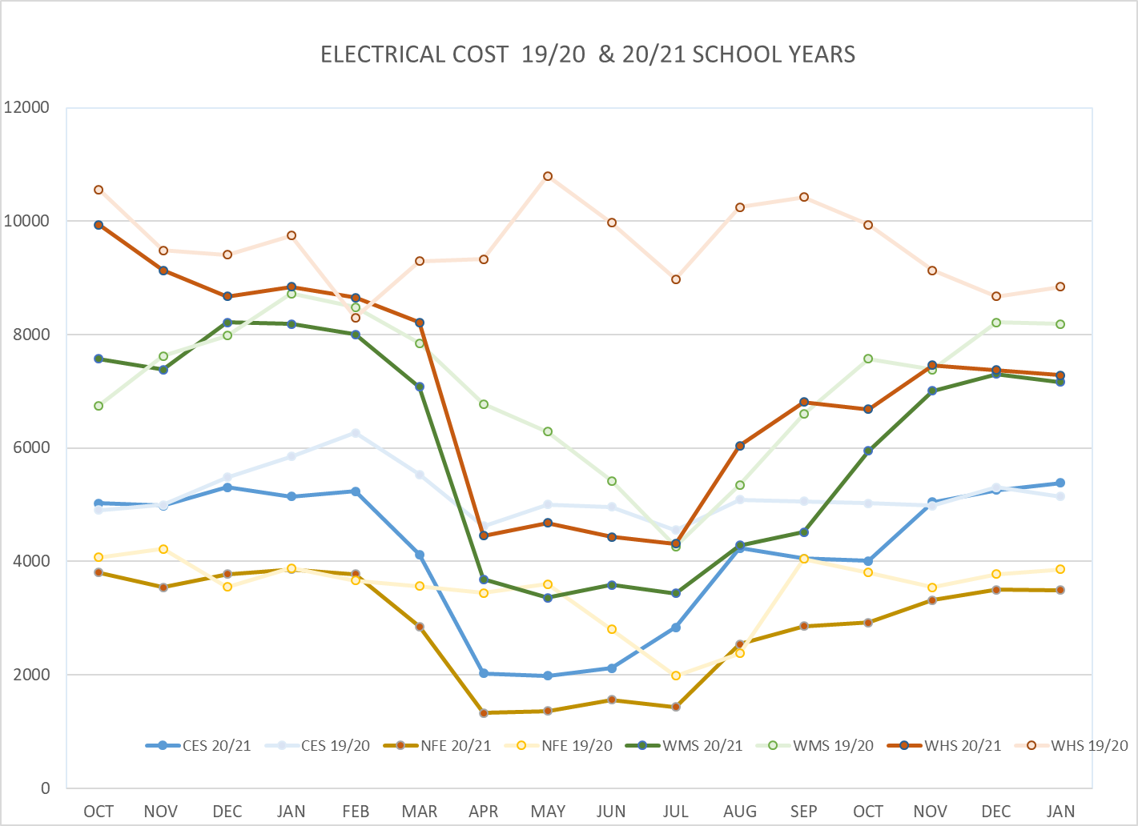
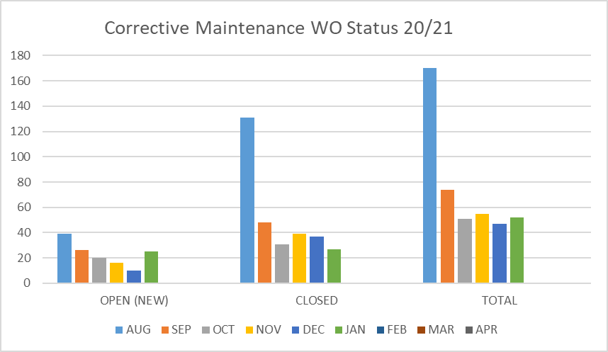
FACILITY CHARTS – POWER COST AND WORK ORDER STATUS

Slide 4
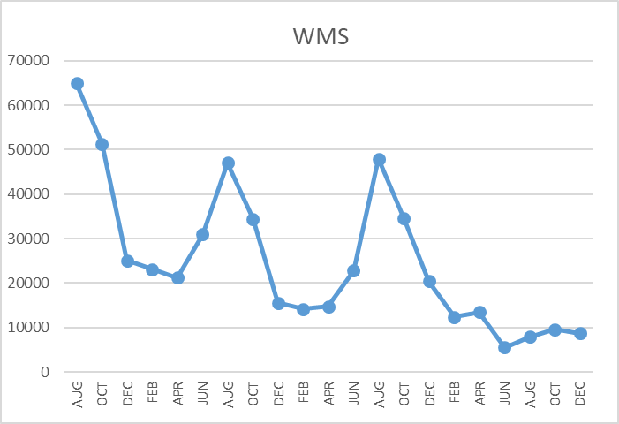
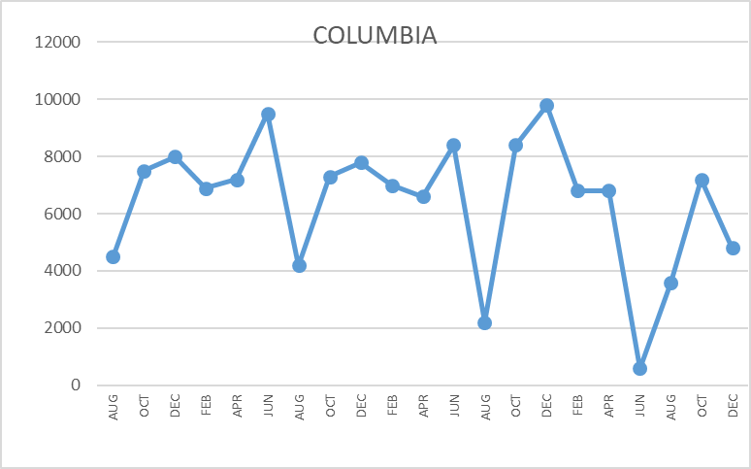
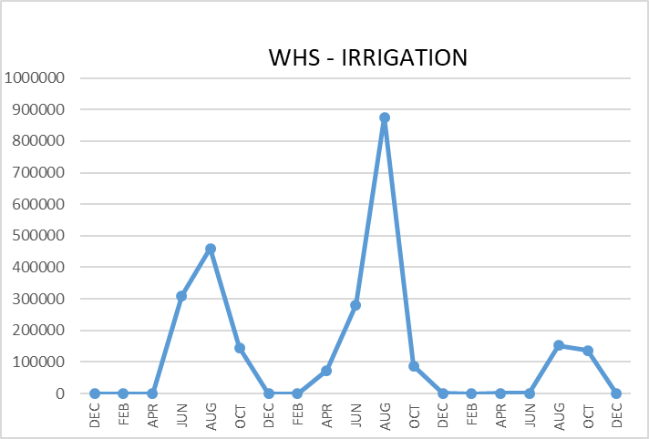
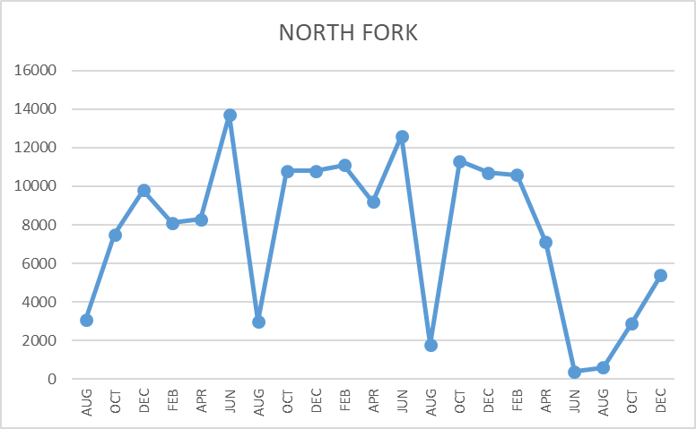
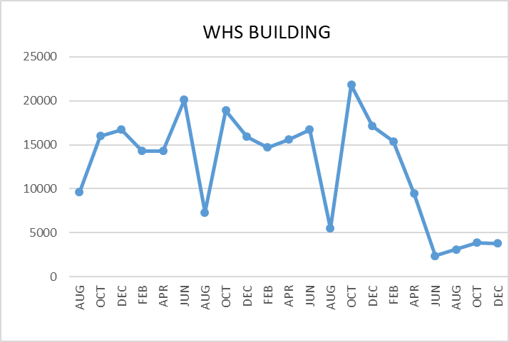
FACILITY CHARTS WATER USAGE WHS, NFES, WMS, CES
Note
Water charts are updated every two
months. Next update to these charts in the March 2021 report.
The WMS chart includes the following 7 meters: 755 Park high and low flow, BO and TEAM High, PIT house, bus barn, athletic field, and DO. All of these meters are totaled on the WMS graph, but each data point is recorded separately to aid in identifying leaks.

Slide 5
Safety Summary
Staff Accidents/Incidents
NFES -Staff member caught shoe on floor, tripped and bruised their left knee.
CES – Escalated student pushed employee, fell backwards and strained their back.
Student Accidents/Injuries
WMS – Escalated student bit own arm, minor skin abrasion.

